Slide 1
Video Project
Ashley Harris

Slide 2
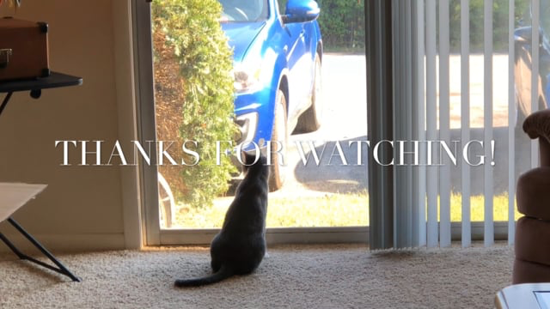
The Video

Slide 3
Storyboard to Screen
The video is slightly different than what I had planned out in the storyboards.
Originally it emphasized the contrast of Luna’s personality more
Lazy Housecat vs. Energetic Spaz
Used movement to try and incorporate some of that contrast

Slide 4
Fun, playful mood
To convey a fun, playful mood, I used:
Sound: cheery music from iMovie theme ‘Playful’
Lighting: Mostly natural light, filmed during daytime
Angles: Lower angles in line with Luna’s eye-level

